Slide 1
π
- Day
Making a beautiful Saturn

Slide 2
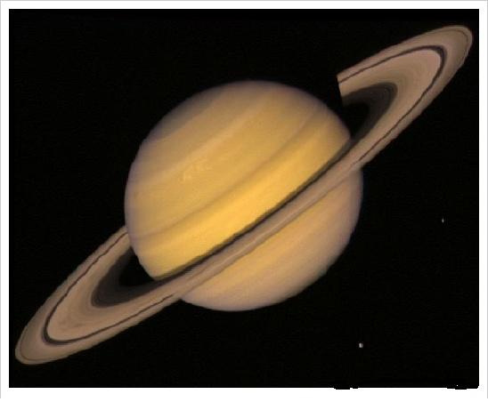

Slide 3
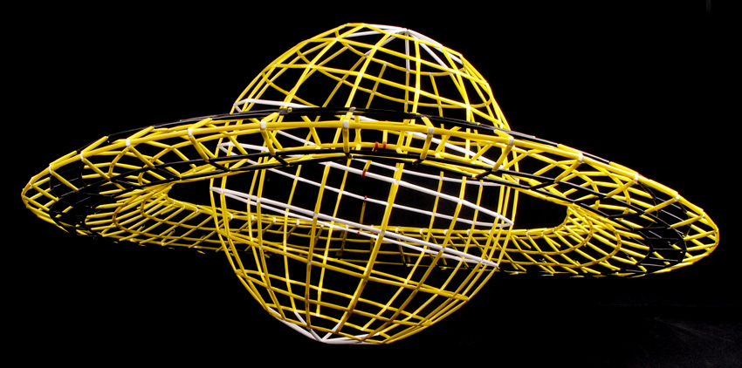

Slide 4
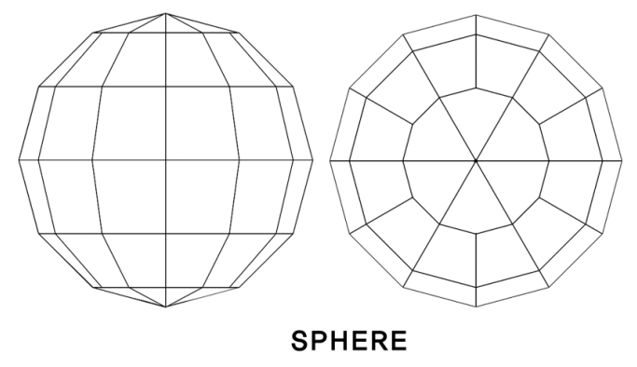

Slide 5
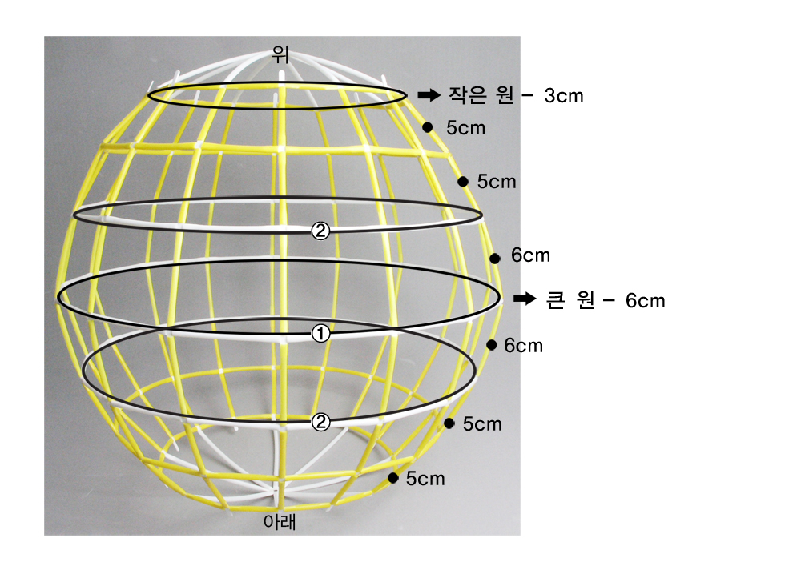

Slide 6
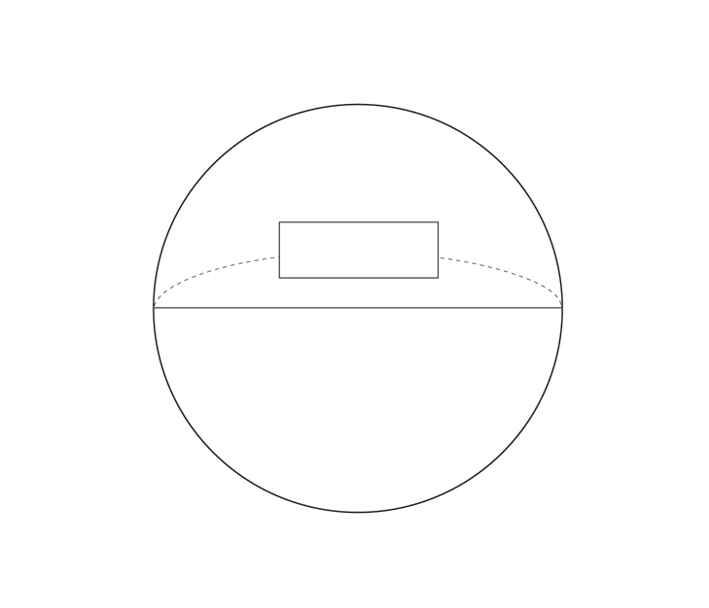
2πr
2r
circumference≒diameter X 3.14

Slide 7
.

Slide 8
.
B
.
A

Slide 11
< Example >
30cm

Slide 12
diameter
circumference
30cm X 3.14 = 94.20cm
Frame length
94.20cm ÷ 16 ea = ? cm
or
94.20cm ÷ 12 ea = ? cm

Slide 13
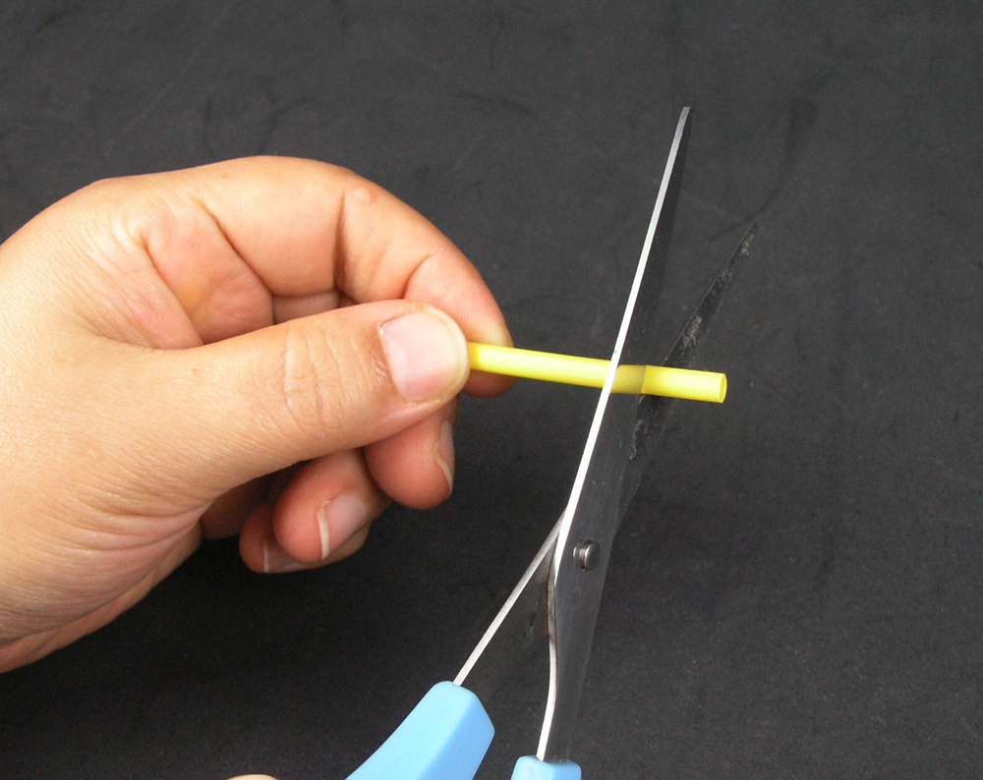

Slide 15
diameter
circumstance
30cm X 3.14 = 94.20cm
( 94.20 – 8 ) ÷ 16 ea = 5.39cm
Frame length
[difference of 4 pod] 0.5cmⅹ16ea = 8cm

Slide 16
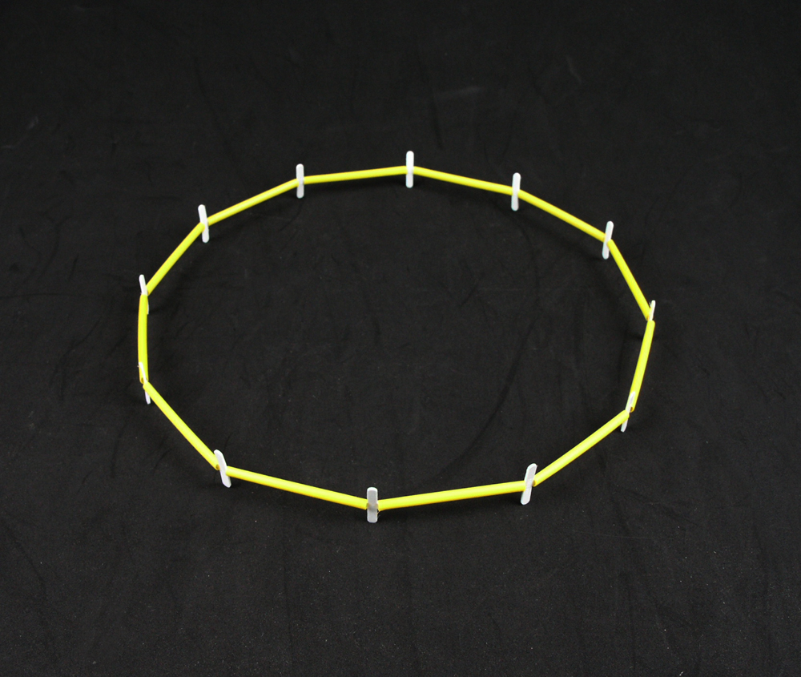

Slide 17
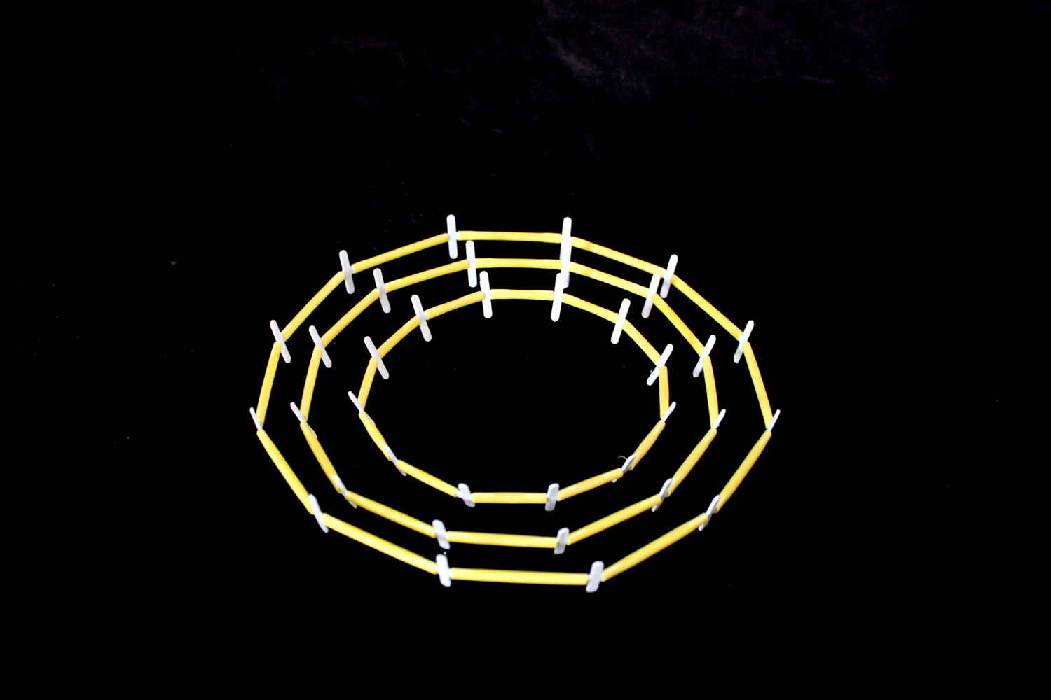

Slide 18
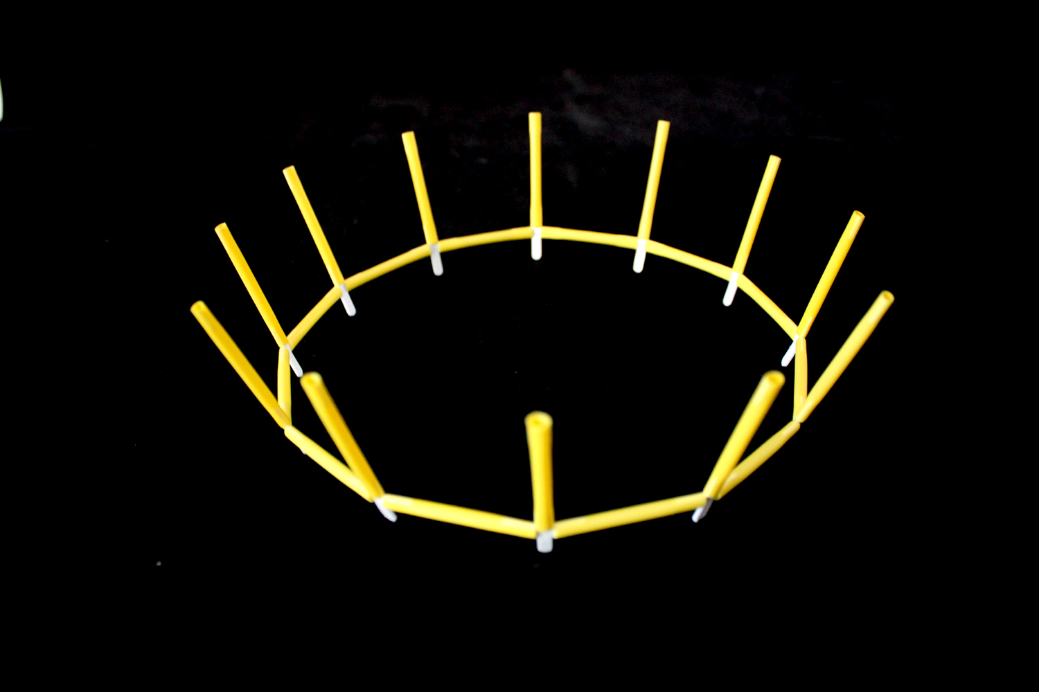

Slide 19
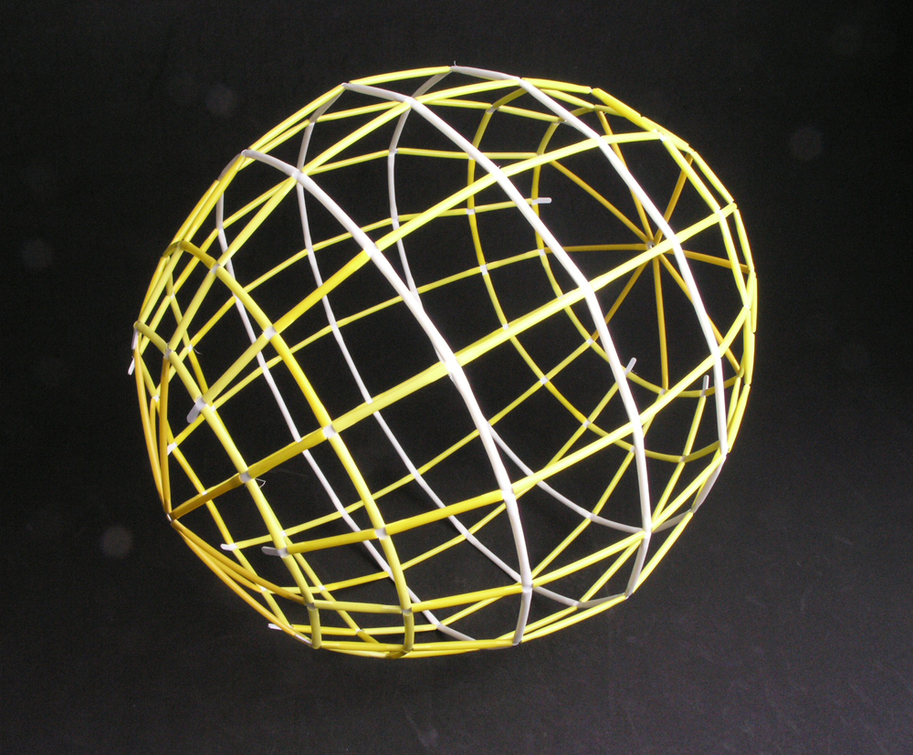

Slide 20
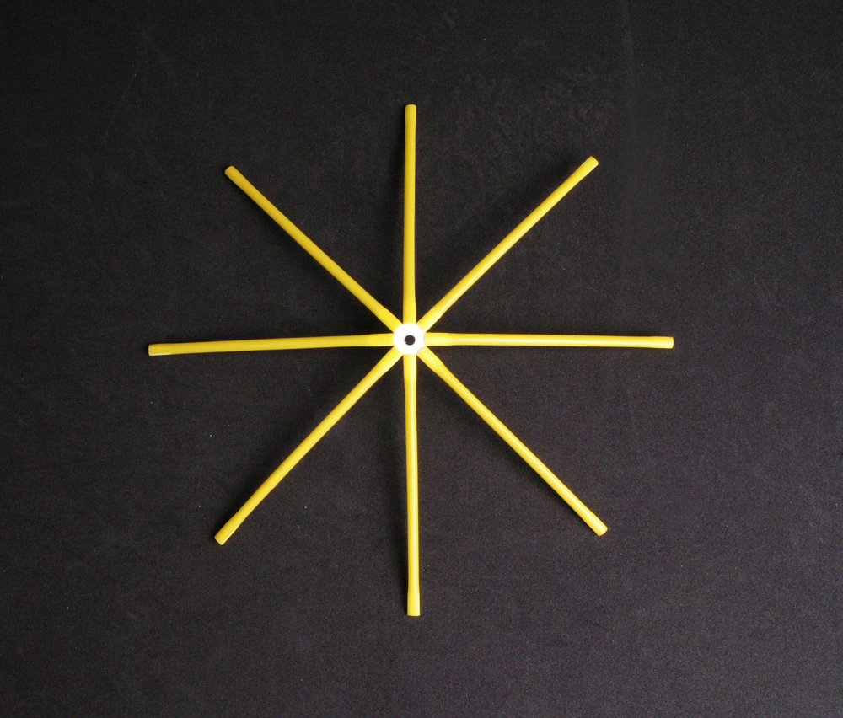

Slide 21
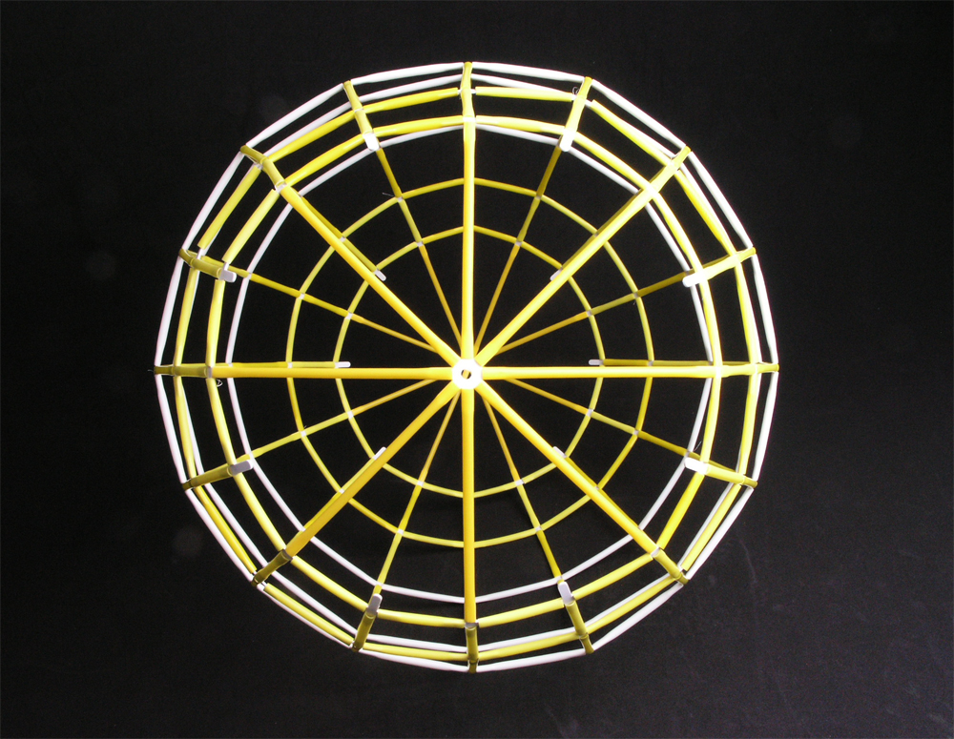

Slide 22
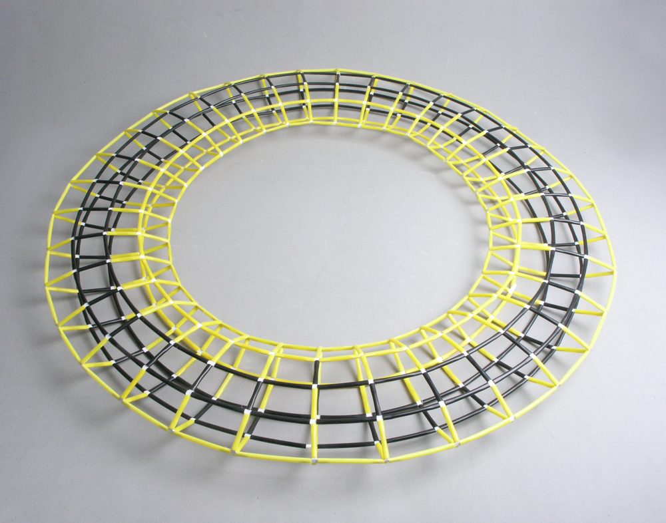

Slide 23
< Example >

Slide 24
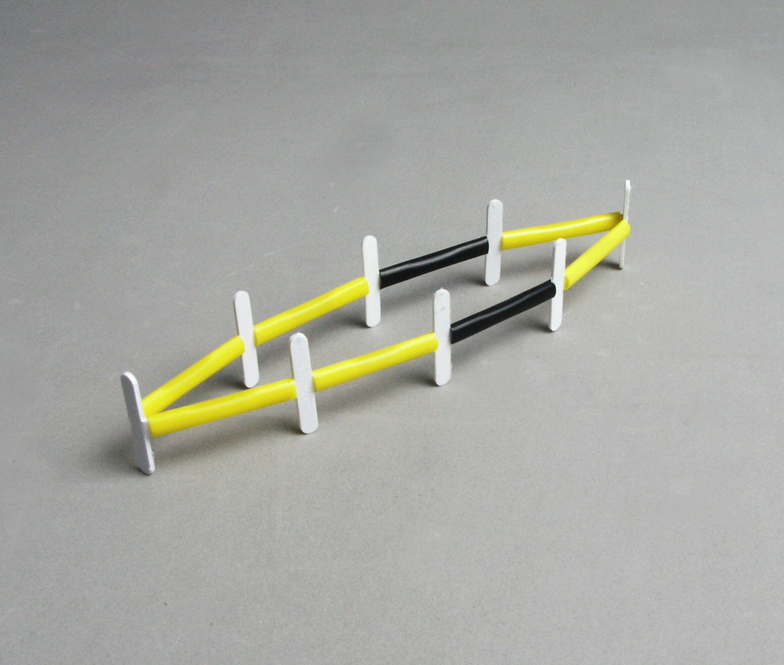
3cm

Slide 25
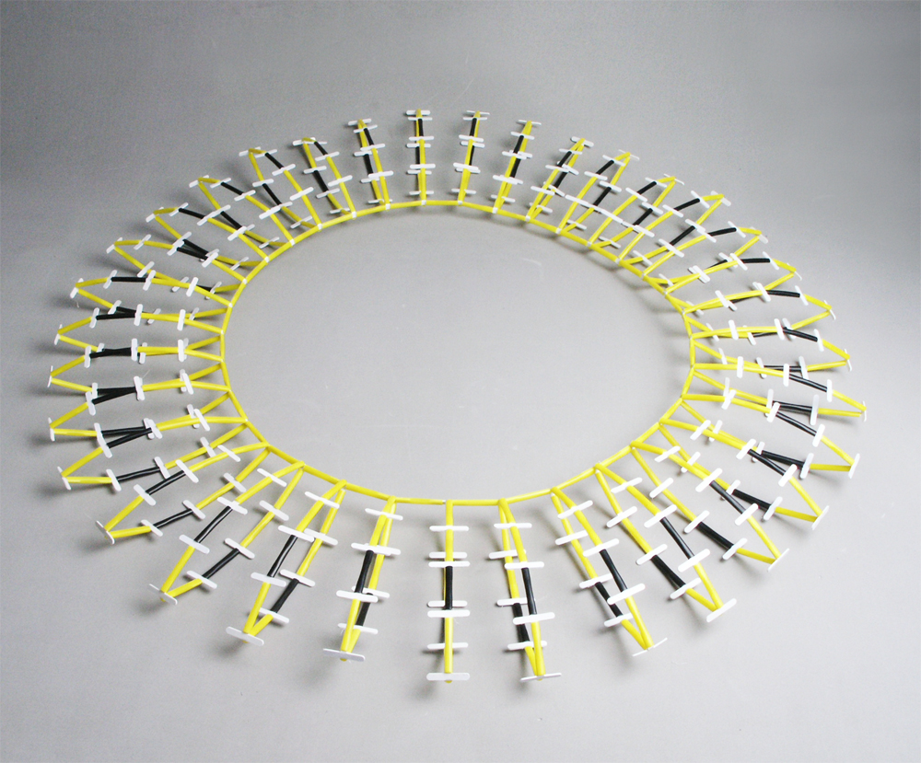
3cm

Slide 26
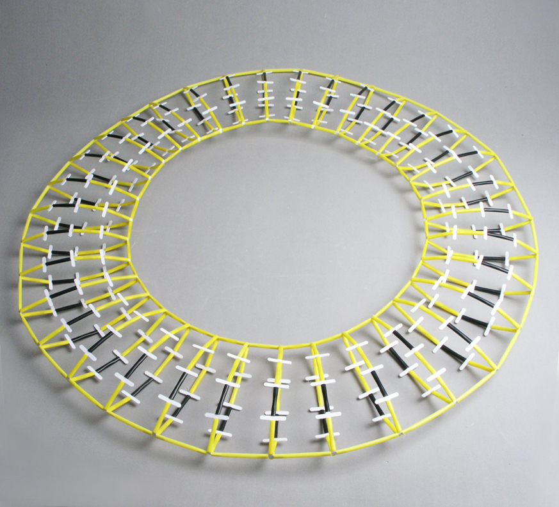
6cm

Slide 27
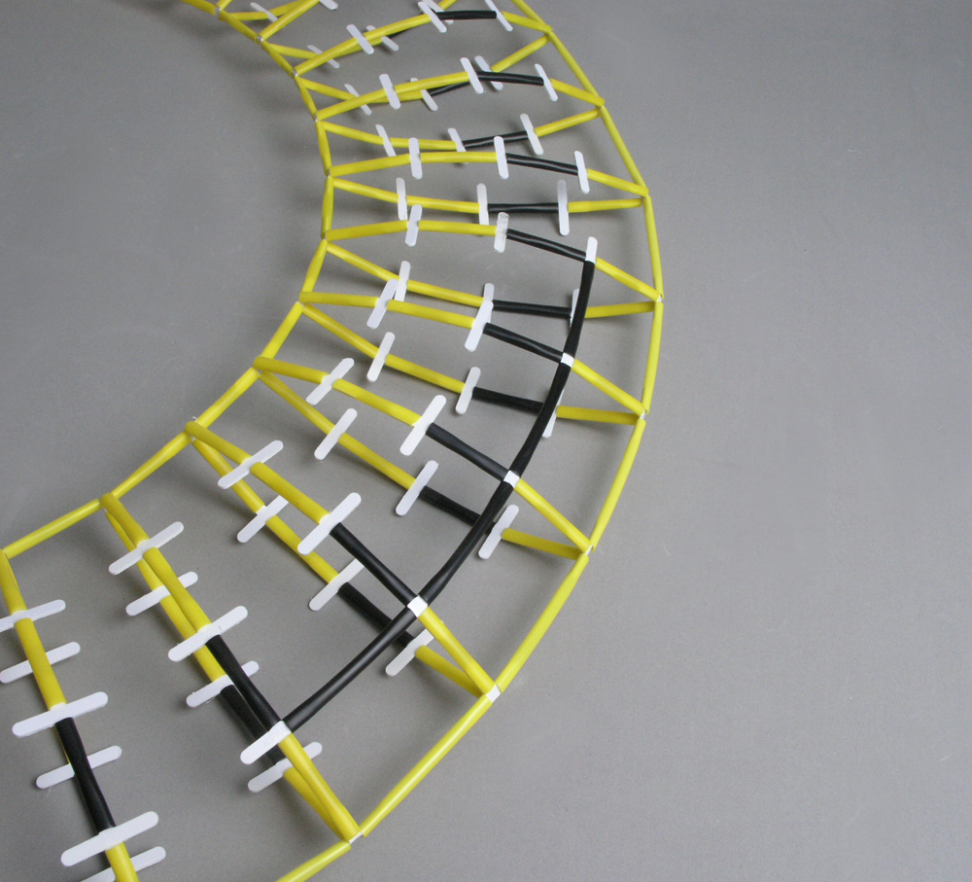
5cm

Slide 29
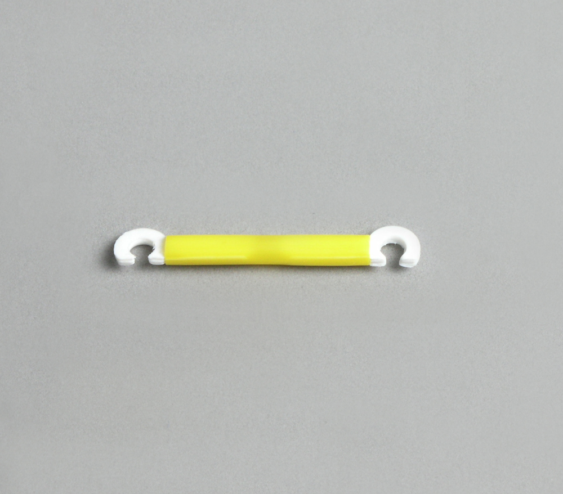
3.5cm

Slide 30
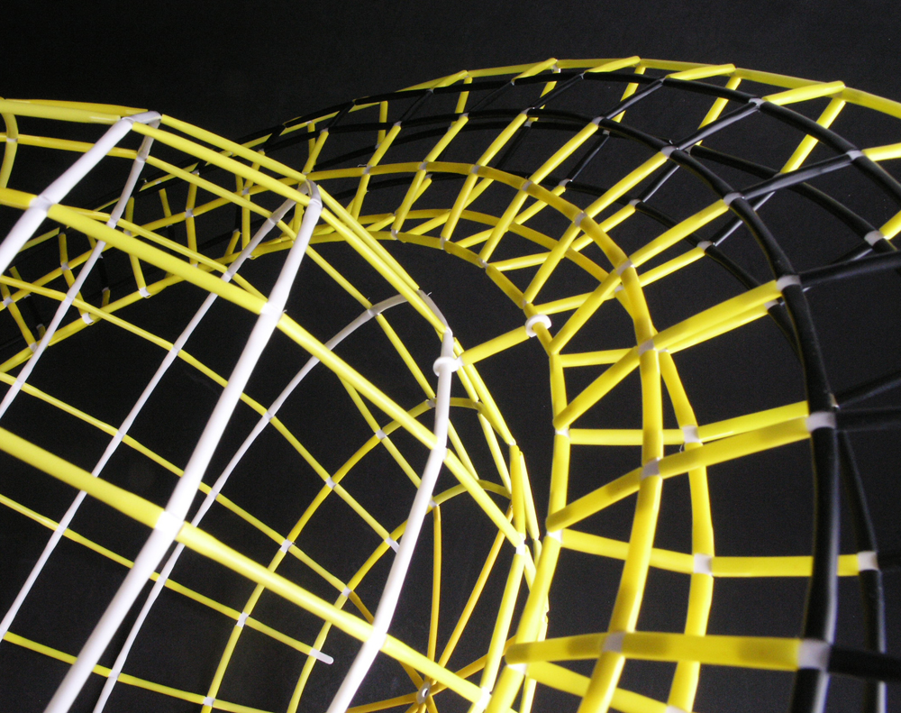

Slide 32
diameter
circumference
X cm X 3.14 = Y cm
( Y cm – 8 ) ÷ 16개 = Z cm
difference
Frame length

Slide 33
Now, you can make your own Saturn with π~!
-The End-

